Slide 1

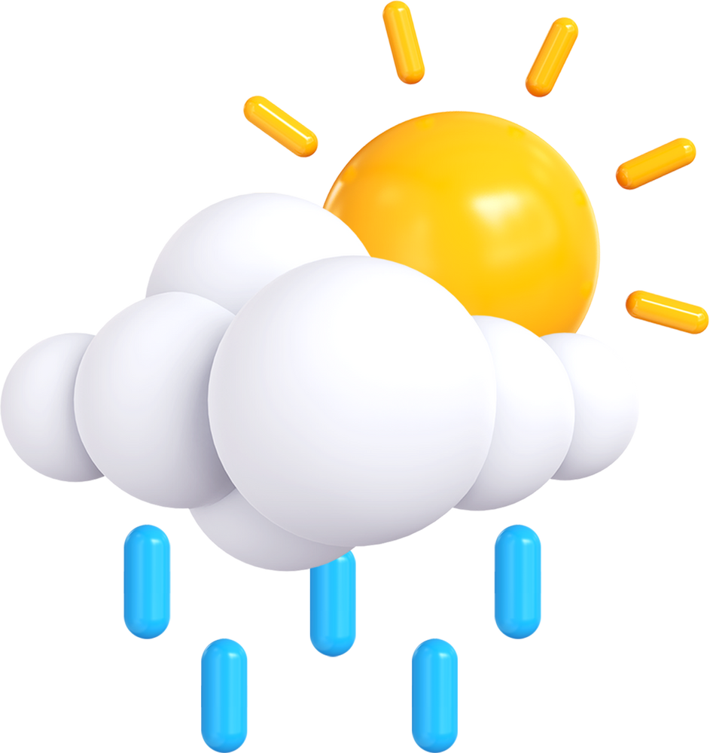
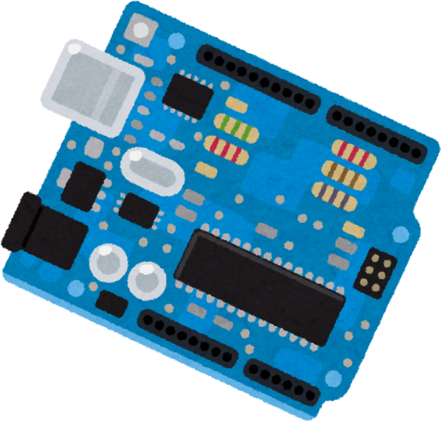


WEATHER STATION

Slide 2


MAIN IDEA :
We have created a weather station equipped with five sensors that measure various values: humidity, temperature, precipitation, atmospheric pressure, and luminosity. These values are displayed on an LCD screen. We used Java to read the data transmitted by Arduino and send them to a database for archiving. At the same time, the data can be accessed through an interface that displays them clearly.
Additionally, our station allows us to monitor atmospheric pressure trends, whether rising or falling. A sound and visual alarm is triggered in the event of a rapid drop in pressure to warn of the probable arrival of strong winds or a storm. High pressure is generally associated with good weather, while low pressure indicates bad weather. Very low pressure, in particular, is often linked to strong winds or storms. A rapid drop in pressure, which often precedes a storm, is the primary criterion used to activate our storm alarm.

Slide 3
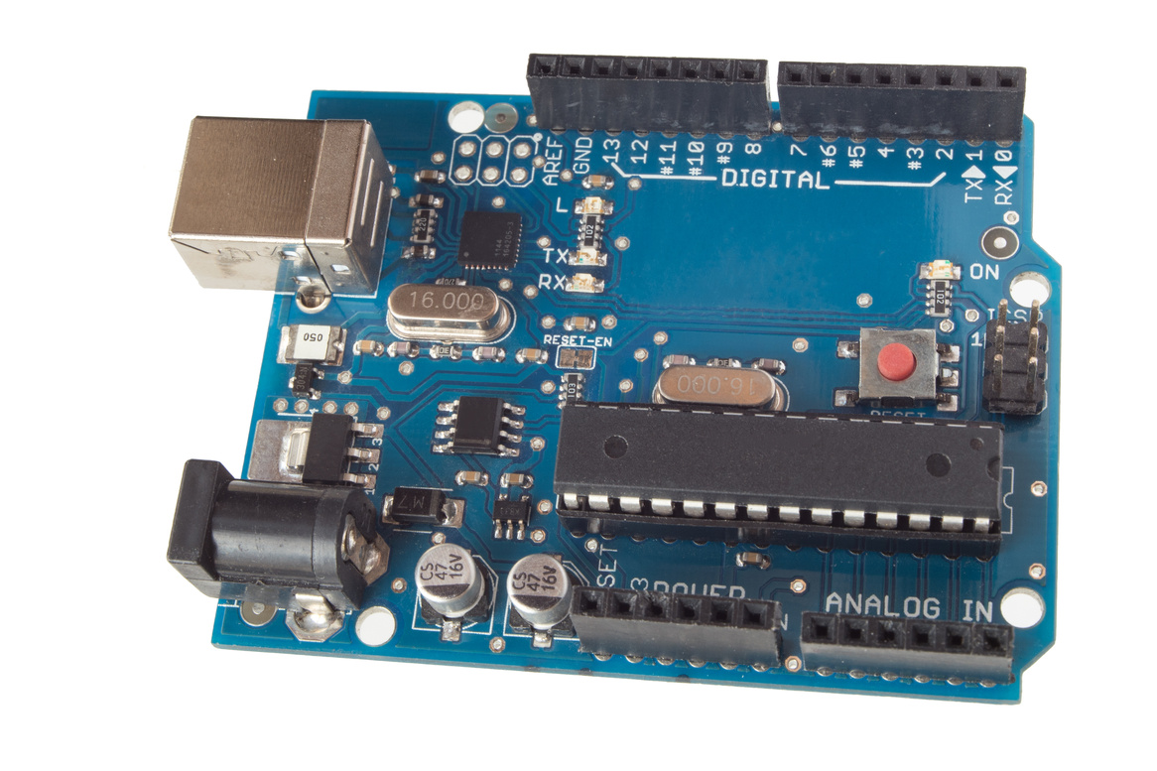
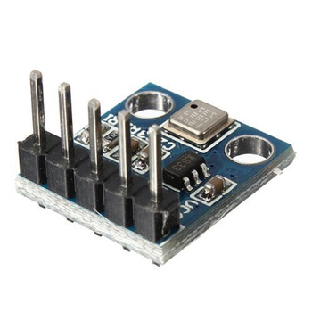
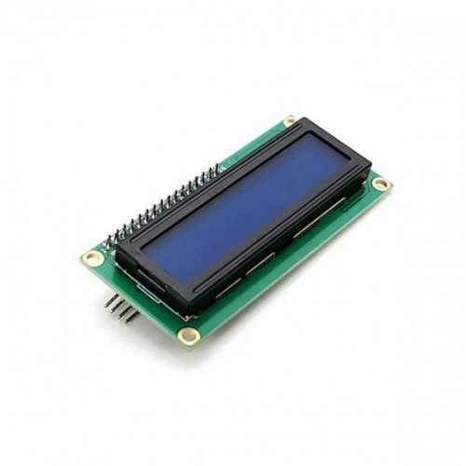
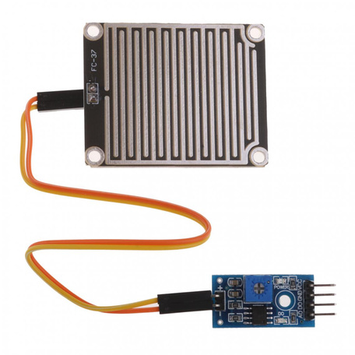
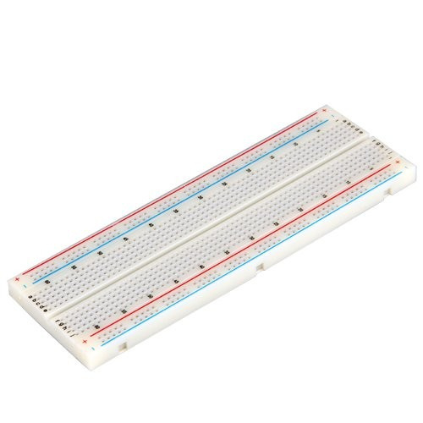
HARDWARE :
Capteur de Pression : BMP 180
carte ArduinoUno
LCD i2c
Capteur de pluie
Breadboard

Slide 4
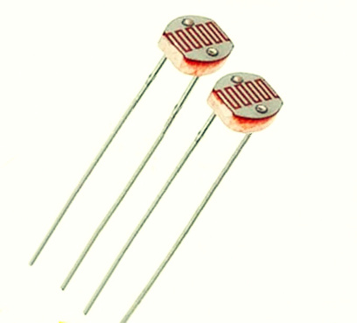
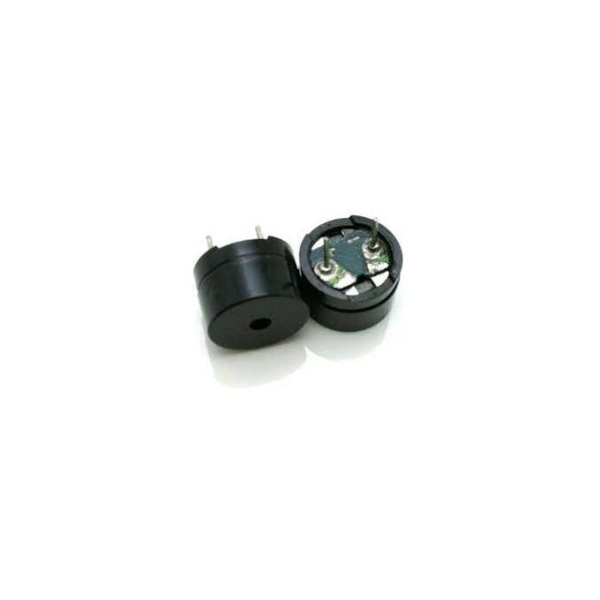
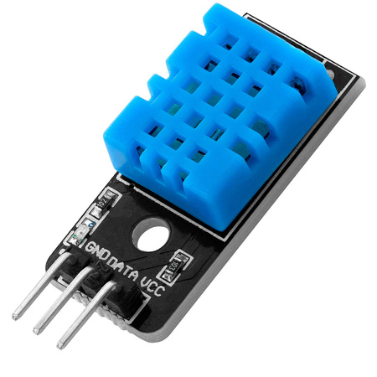
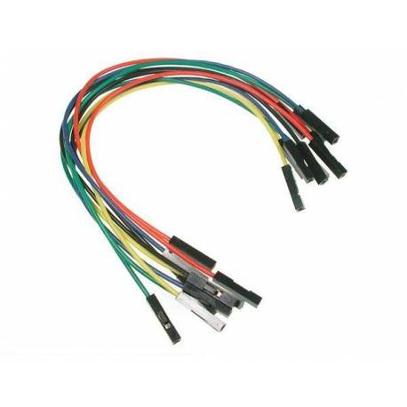
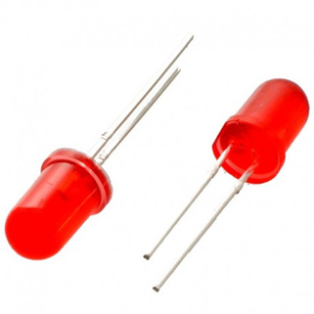
HARDWARE :
Buzzer passif
Idr photorésistant
Capteur Temperature et d’humidité : DHT 11
leds
connecteurs

Slide 5
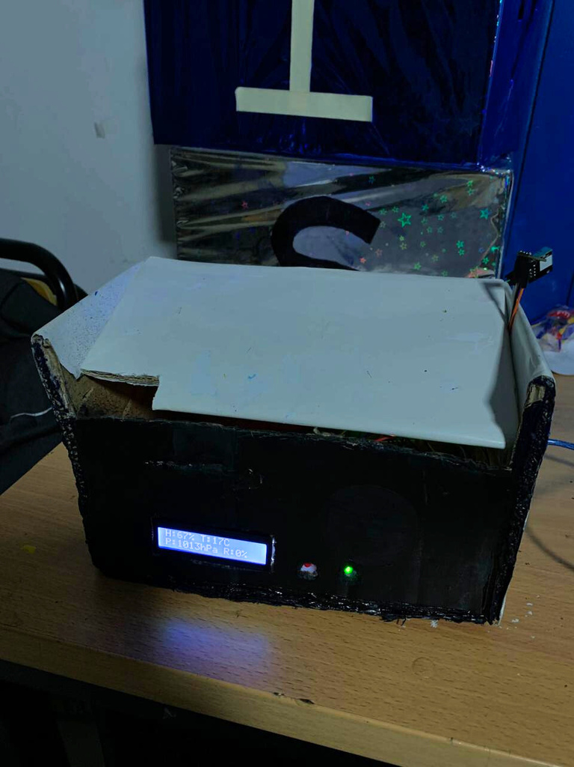
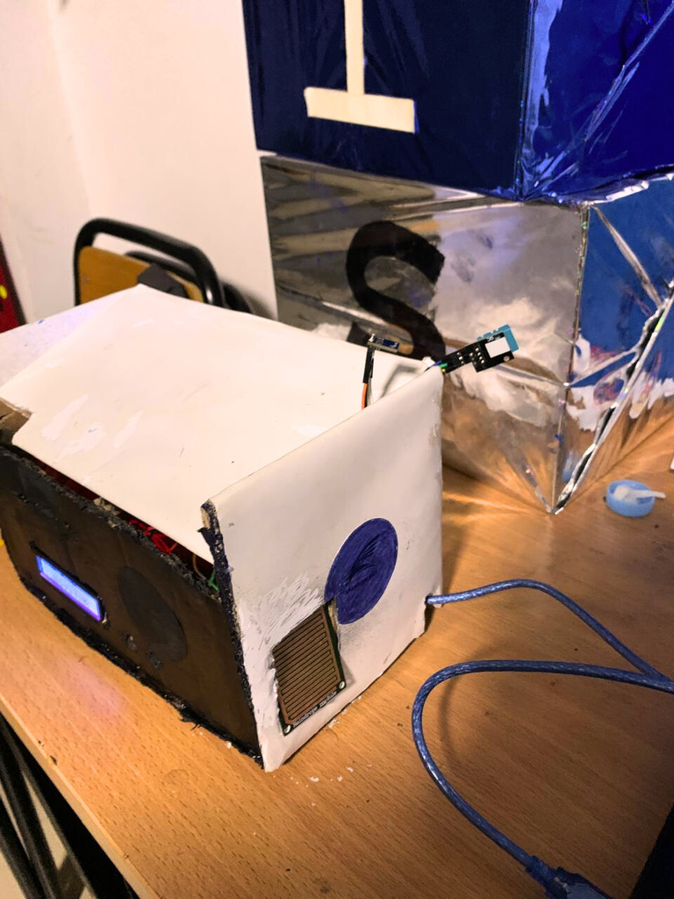
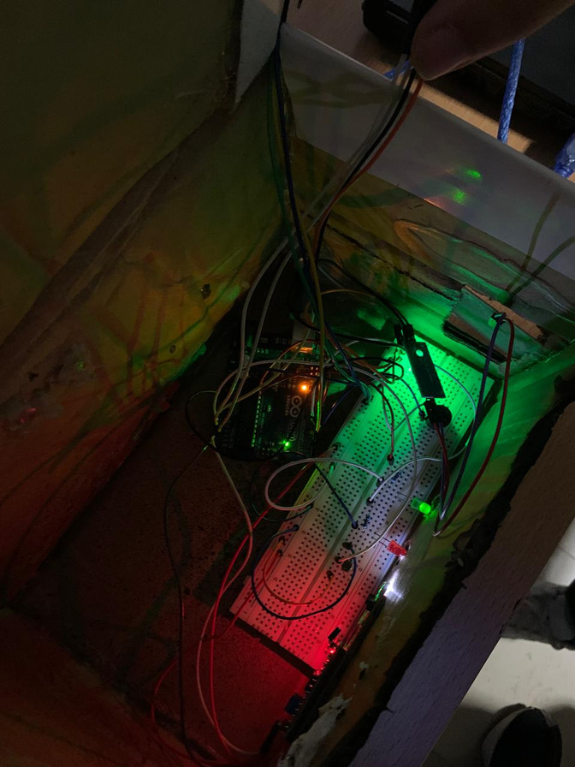
PROTOTYPE :

Slide 6
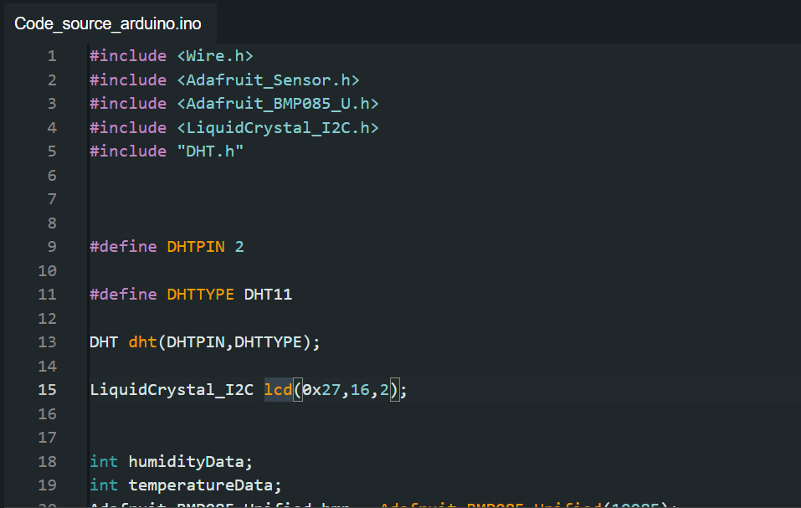
CODE ARDUINO :
Importation of libraries to work with the sensors. initialize the variables and assigned each sensor to the pin where it will be connected.

Slide 7
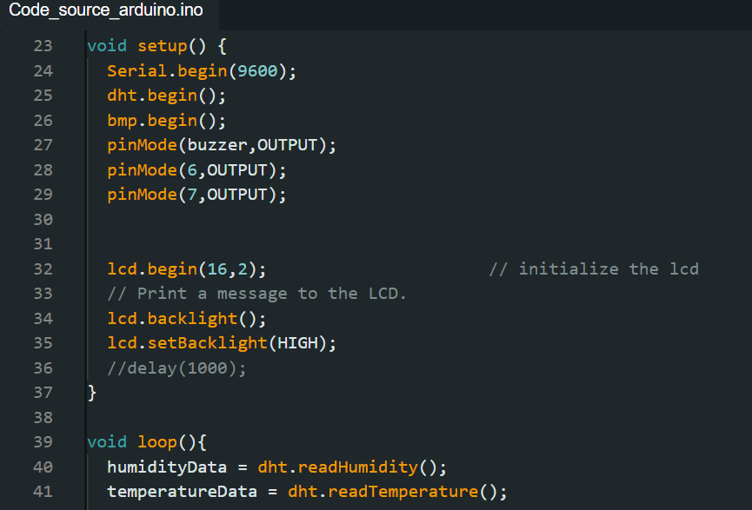
CODE ARDUINO :
The functions that will read the values ​​from the sensors and give each pin where the sensors are connected its input or output function

Slide 8
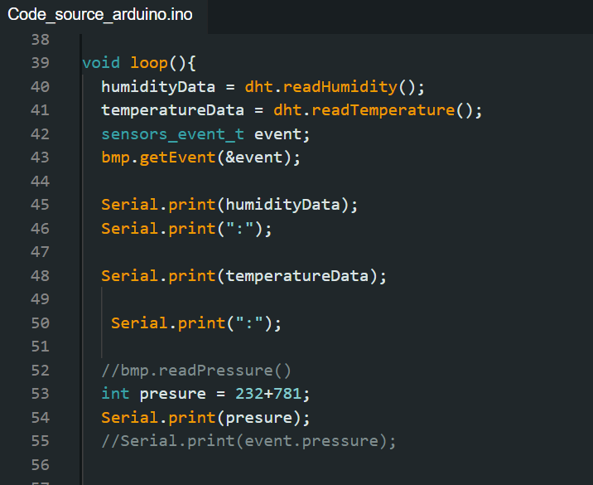
CODE ARDUINO :
Measure the values ​​at the sensors to assign them to their variable and then display them in the serial monitor and in the LCD screen

Slide 9
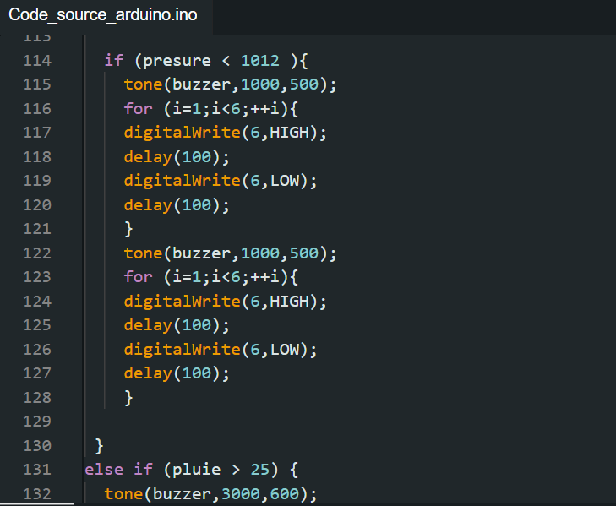
CODE ARDUINO :
Alarm system that tells us whether a storm exists or not, as you can see if the pressure is lower than 1012, we have the buzzer with a low frequency and a very rapid flashing of the red LED.

Slide 10
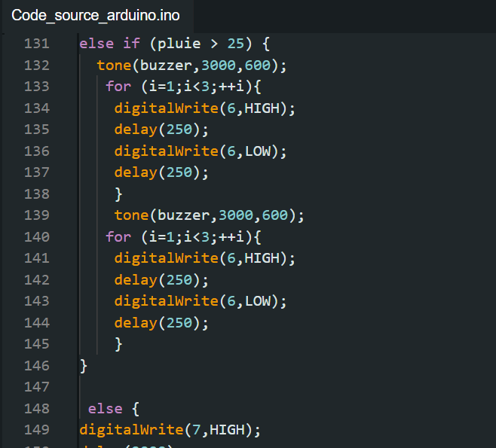
CODE ARDUINO :
Alarm system that tells us that there is a significant amount of rain, we have the buzzer with a higher frequency than the first system and a slow flashing of the LED.
No storm no rain, the green LED will light up.

Slide 11
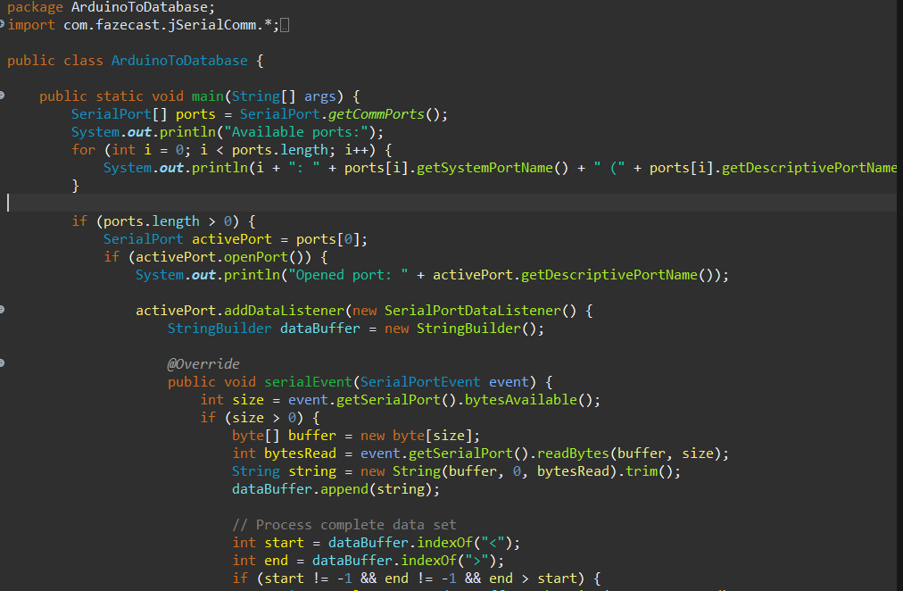
CODE JAVA :
The Class ArduinoToDatabase, is designed to read data from an Arduino device connected via a serial port and insert that data into a MySQL database.

Slide 12
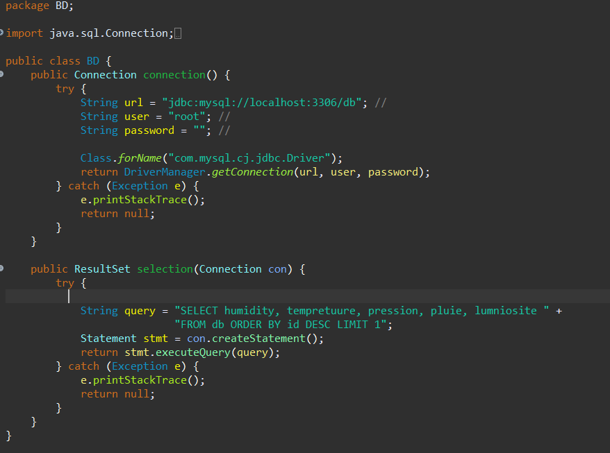
CODE JAVA :
The Class DB, is responsible for establishing a connection to a MySQL database and retrieving data from it

Slide 13
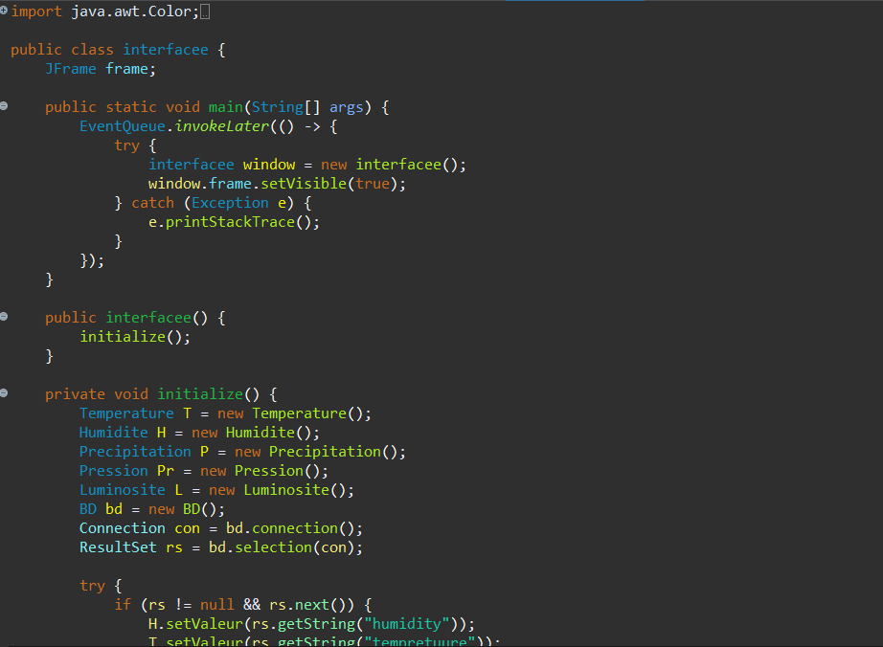
CODE JAVA :
The Class interfacee,interfacee provides a graphical user interface (GUI) for displaying weather data.

Slide 14
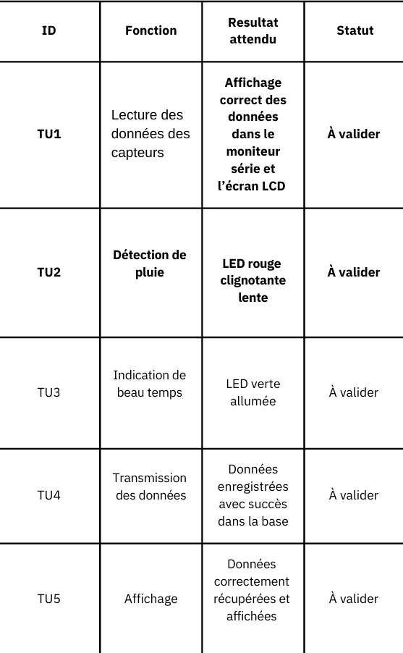
UNIT TEST DOCUMENT:

Slide 15
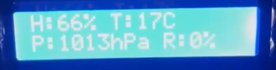
TEST 1 :

Slide 16
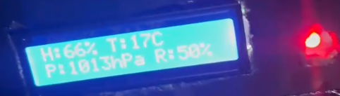
TEST 2 :

Slide 17
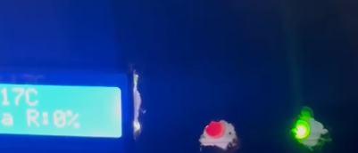
TEST 3 :

Slide 18
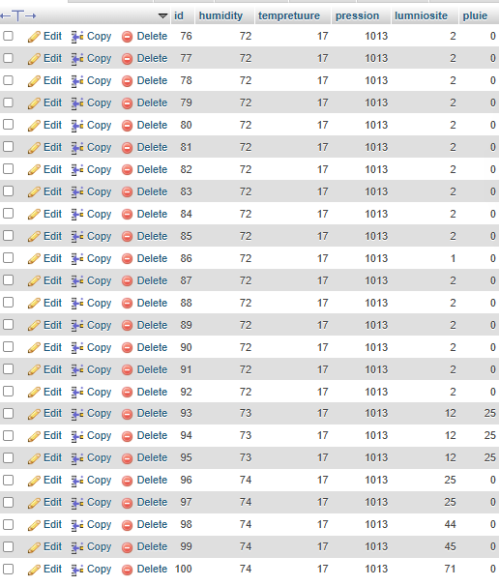
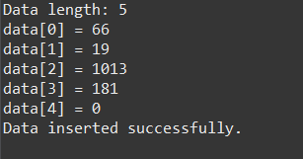
TEST 4 :

Slide 19
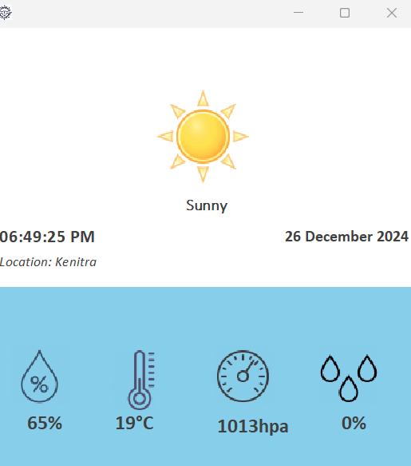
TEST 5 :

Slide 20
Code line: 704
Number of Classes: 10
Number of Tests: 5
Number of graphical interfaces : 1
Report : 14

Slide 21
THANK YOU
FOR YOUR
ATTENTION !

